Slide 1

SEETELL An Image to Speech Converter
Department of Information Science & Engineering
BMS College of Engineering
Under the guidance of
Surabhi Sanjiv K.
ISE Faculty, BMSCE
Presented by
Rozelle Jain (1BM13IS066)
Shantanu Das (1BM13IS073)

Slide 2

INTRODUCTION

Slide 3
Globally as many as 285 million people suffer from visual impairment, out of which 39 million are completely blind.
India alone accounts for 20% of global blind population.
These people face difficulties in performing as basic a task as reading.

Slide 4
Digital copies of information proves to be more usable than hard copies.
Lately, high performance imaging devices are easily available which are portable, cost-effective and can be easily integrated with other systems.
These imaging devices are rapidly replacing traditional desktop scanners.

Slide 5
There should be a system to:
Assist visually impaired people with reading documents (newspapers, books, mails, magazines, commercial product’s label) or text in natural scenes (signs, screen, schedules)
Help people who suffer from learning or literacy disabilities
Helps convert printed/handwritten documents into digital format.

Slide 6
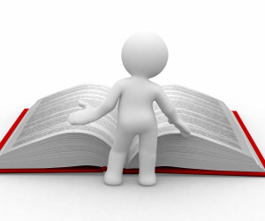
LITERATURE SURVEY

Slide 7
Jisha Gopinath, et.al published “Text to Speech Conversion System using OCR” in IJETAE, 2015
K. Kalaivani, et.al published “Real Time Implementation of Image Recognition and Text to Speech Conversion” in IJAERT, 2014
Partha Sarathi Giri published “Text Information Extraction and Analysis from Images using DIP Techniques” in IJACTE, 2013

Slide 8
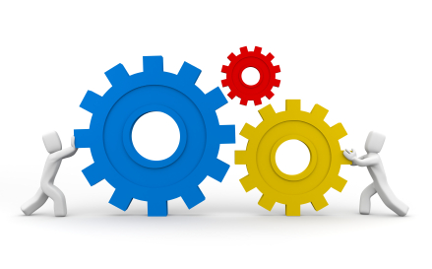
EXISTING SYSTEMS

Slide 9
Initial speaking machines - Albertus Magnus (1198-1280),Gerbert of Aurillac(d.1003 AD), and Roger Bacon (1214- 1294)
The first successful prototype for reading machine developed by the Haskin Laboratories in the 1970s.
The text reciting systems which are already in existence- ‘I-Scan’, ‘Kurzweil 1000’, ‘Cicero text reader’, ‘Open Book’, ‘Ovation’, ‘Scan N Talk’, ‘VERA’ etc. Cost: more than 2 lakh INR.

Slide 10
Intel announced a text reading device by the end of 2009 Cost: nearly 80,000 INR.
‘Optelec Clear Reader+ Advanced’ - text reading device introduced in 2010. Cost: over 1 lakh INR.
Android and IOS mobile applications exists to convert image to speech - I2S OCR - Image to Speech, VoxDox, Picture Speech etc. However these are paid applications and not user friendly for the visually impaired.

Slide 11

PROPOSED SYSTEM

Slide 12
Standalone application which is platform independent and portable.
Support for natural images, uploaded images and PDF documents.
User friendly interface.
Included features like dictionary and speech control.
Freely available, open source.

Slide 13
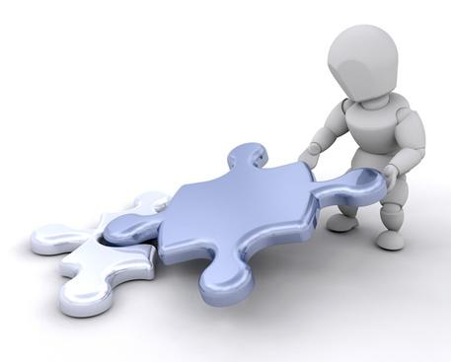
DESIGN

Slide 14
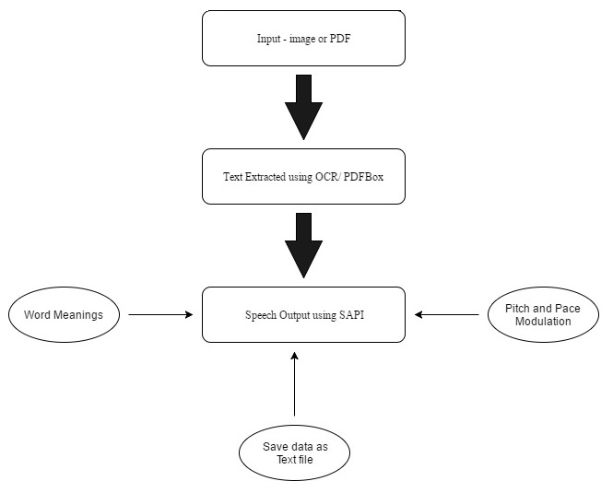
High level design

Slide 15
Detailed diagram (Image to text)

Slide 16
Detailed diagram (Text to Speech)

Slide 17
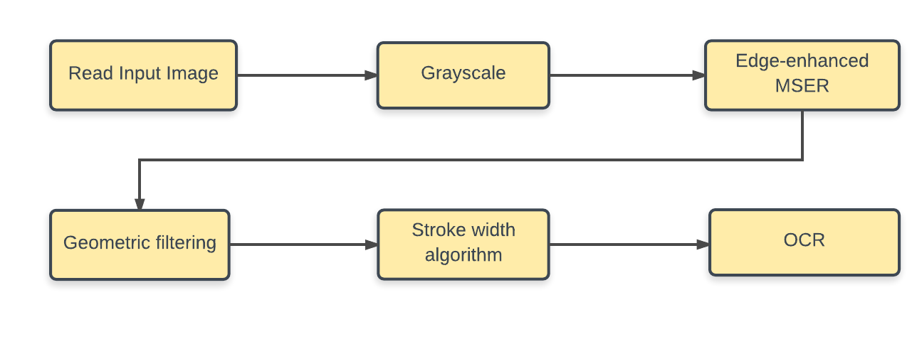
Matlab R2016b was used as the programming tool.
GUI was developed using Matlab.
MSER feature detector, Stroke Width Algorithm was used for finding the text regions.
OCR was used to recognize text from detected regions.

Slide 18
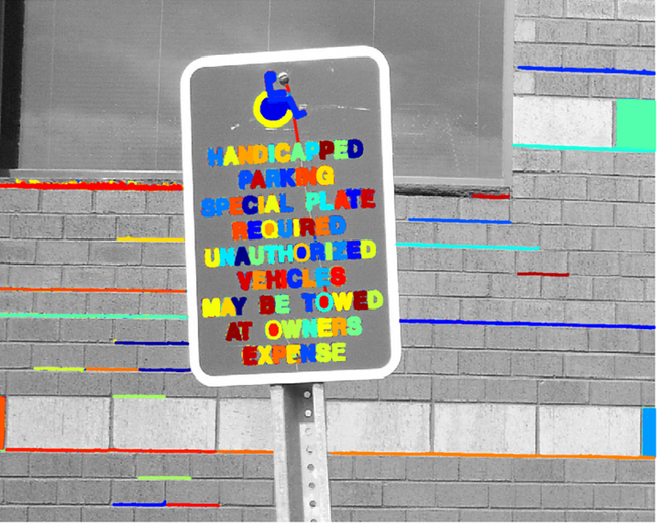
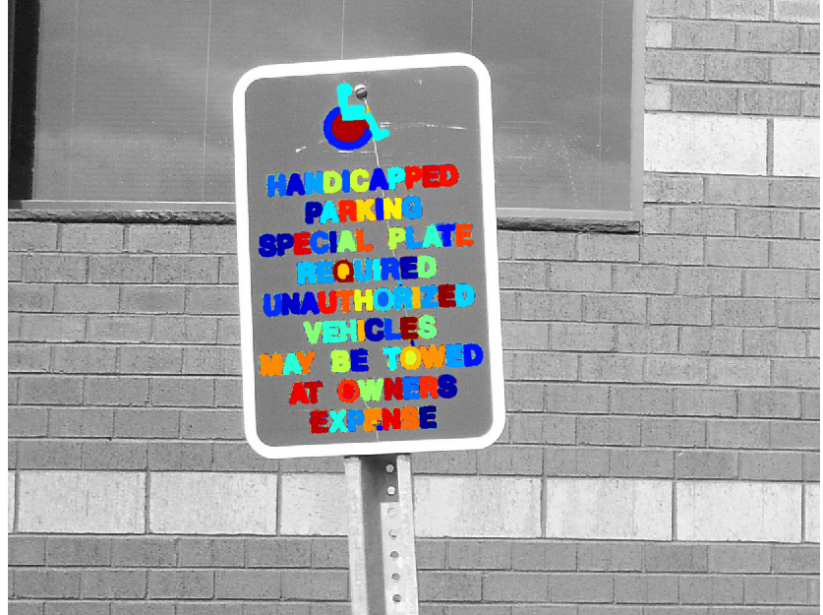
MSER feature detector
Detect Candidate Text Regions Using MSER
Remove Non-Text Regions Based On Basic Geometric Properties

Slide 19
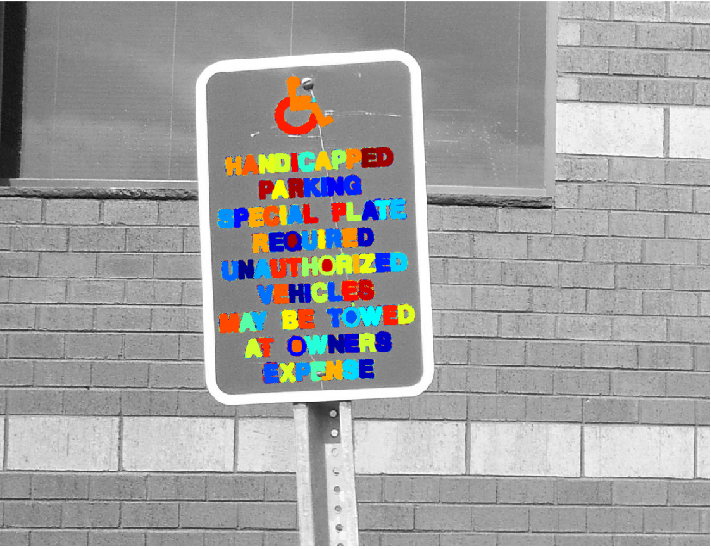
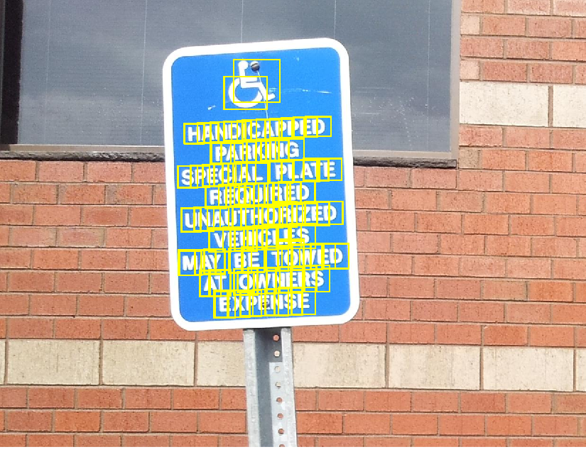
Stroke Width Algorithm
Remove Non-Text Regions Based On Stroke Width Variation
Merge Text Regions For Final Detection Result

Slide 20
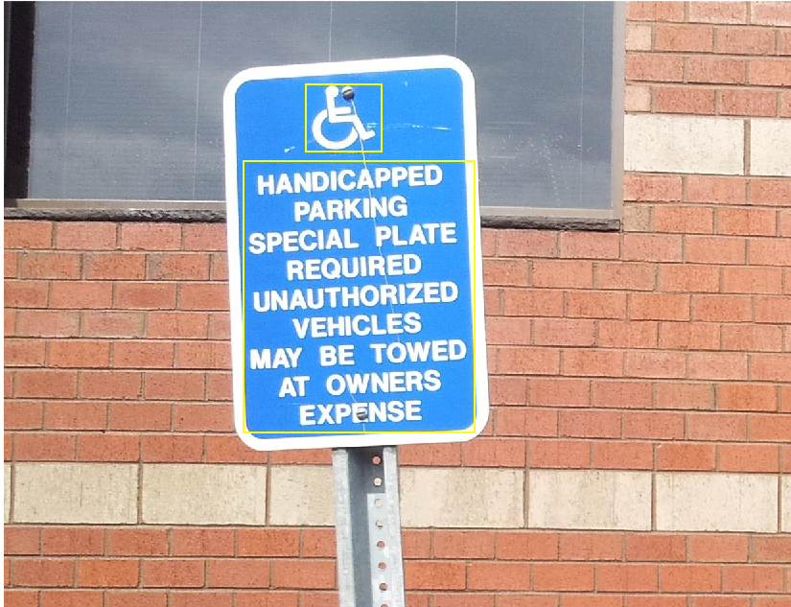
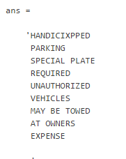
Optical Character Recognition
Detected region containing text
Detected Text using OCR

Slide 21

RESULT

Slide 22
SeeTell helped to achieve the following:
Offers a one stop solution with the availability of dictionary as an added feature to image to speech conversion, which is not provided by any existing systems.
Another novel feature of SeeTell is that input can be provided as a natural image, upload an image containing text or upload a PDF document
Functionalities of pitch and pace modulation of speech provided.
Expensive hardware components, installation of any other software or even internet connection is not required.

Slide 23

CONCLUSION

Slide 24
SeeTell can prove to be useful in various aspects:
Helps users to multitask
Helps visually impaired people specially those who cannot red in Braille too
Provides a fun way for children to learn
Provides a solution to those who wish to learn the language

Slide 25
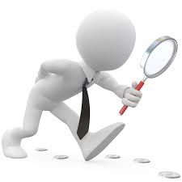
FUTURE SCOPE

Slide 26
Support for other languages
Support for providing input in various other formats
Algorithms to recognize text from blur and low resolution images can be developed

Slide 27

QUERIES

Slide 28

THANK YOU

